Slide 1





Sales Data Analytics
project
Done by : Aayub Sayyad

Slide 2




Mission Statement
Empower Organization with actionable insights and strategic foresight.
Optimize sales performance and enhance customer relationships.
Sustainable growth.

Slide 3


Table of contents
01
Introduction
Project Overview
02
Objectives
Deﬁne Goals
03
Data Collection and Preparation
Data Sources
04
Data Analysis and insights
Key Findings
05
Recommendations
Actionable Insights
06
Conclusion and Next Steps
Further analysis

Slide 4

01
Introduction
PROJECT OVERVIEW

Slide 5



This Sales Data Analytics project aims to optimize sales strategies through comprehensive data analysis.
By examining key metrics such as revenue, quantity ordered, and proﬁt margins, we will uncover actionable insights to drive growth.
Leveraging advanced analytical tools,identiﬁed opportunities for increasing revenue, enhancing proﬁtability, and improving customer satisfaction.This project empowers informed decision-making to stay competitive in the market landscape.

Slide 6
02
Objectives
Deﬁning Goals

Slide 7








Key goals include maximizing revenue through pricing optimization and
product offerings, improving order fulﬁllment efﬁciency, enhancing proﬁt margins, and gaining actionable insights into customer behavior for personalized engagement.
By leveraging data-driven strategies and fostering a culture of continuous improvement, the project aims to position the organization for sustained success in a competitive market landscape.

Slide 8
03
Data Collection and Resources
Data Sources

Slide 9









Data Sources
Excel
Data Cleaning and preparation
MySQL
Data Management and Manipulation
Power BI
Data Analysis and Visualization

Slide 10
04
Data Analysis and Insights
Key Findings

Slide 11


Dashboard Analysis: Our sales analytics dashboard offers a comprehensive view of our sales performance in real-time.
Through interactive charts, graphs, and slicers, stakeholders can easily track key metrics such as revenue, sales volume, and proﬁt margins across different time periods, products, and regions.
The dashboard enables quick identiﬁcation of trends, allowing us to capitalize on opportunities and address challenges promptly. Overall, our sales analytics dashboard provides a simple yet effective way to monitor performance, optimize strategies, and drive business growth.

Slide 12


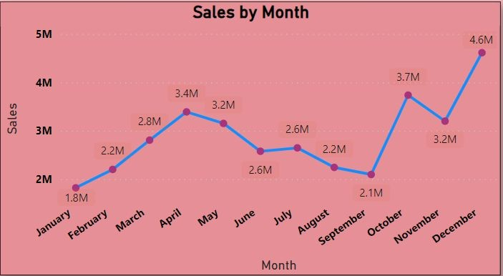
Visualization trends-Line chart
In December, sales peaked at 46,13,443.34, marking the highest monthly total.
This ﬁgure was 153.17% greater than January's sales, the lowest recorded at 18,22,256.73. December's sales represented a notable 13.38% of the annual total.
Throughout the year, sales varied signiﬁcantly, ranging from a low of 18,22,256.73 to a high of 46,13,443.34 across all 12 months.

Slide 13
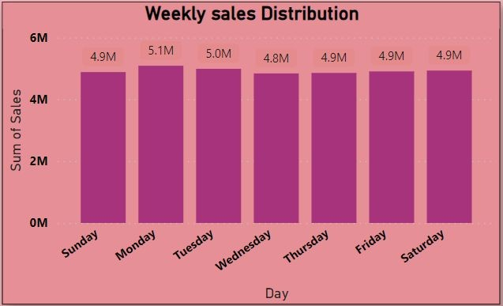
Column Chart-Visual
Monday led the week with the highest sales sum of 50,87,956.78, marking a 5.13% increase over Wednesday's sales total of 48,39,465.16, the lowest recorded for the week.
Notably, Monday's sales accounted for 14.75% of the total weekly sales.
Throughout the seven-day period, sales varied from a low of 48,39,465.16 to a high of 50,87,956.78, highlighting ﬂuctuations across different days of the week.

Slide 14
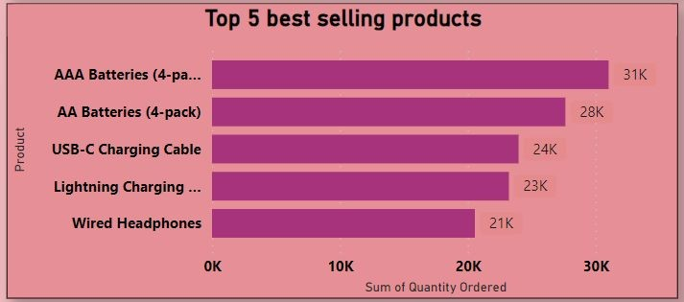
Bar Chart-Visual
In terms of quantity ordered, AAA Batteries
(4-pack) stood out with the highest sum of 31,017
units, surpassing Wired Headphones by 50.88%.
Wired Headphones recorded the lowest sum at 20,557 units. Interestingly, AAA Batteries (4-pack) constituted 24.54% of the total quantity ordered.
Across the ﬁve products analyzed, the range of quantity ordered spanned from 20,557 to 31,017 units, reﬂecting varied demand levels across different product categories.

Slide 15
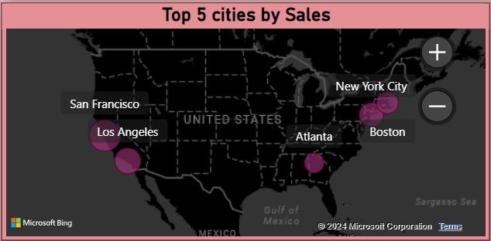
Geospatial Map
San Francisco emerged as the top performer with sales totaling 82,62,203.91, marking a substantial 195.55% increase over Atlanta, which recorded the lowest sales sum at 27,95,498.58.
Impressively, San Francisco's sales contributed to
33.27% of the total sales ﬁgure.
Across the ﬁve cities analyzed, sales ﬁgures ranged from 27,95,498.58 to 82,62,203.91, showcasing signiﬁcant disparities in sales performance across different city markets.

Slide 16






Top 5 cities by sales
04
01
Boston
3.6M
San Francisco
8.2M
02
05
Atlanta
2.7M
Los Angeles
5.4M
New York
4.6M
03

Slide 17
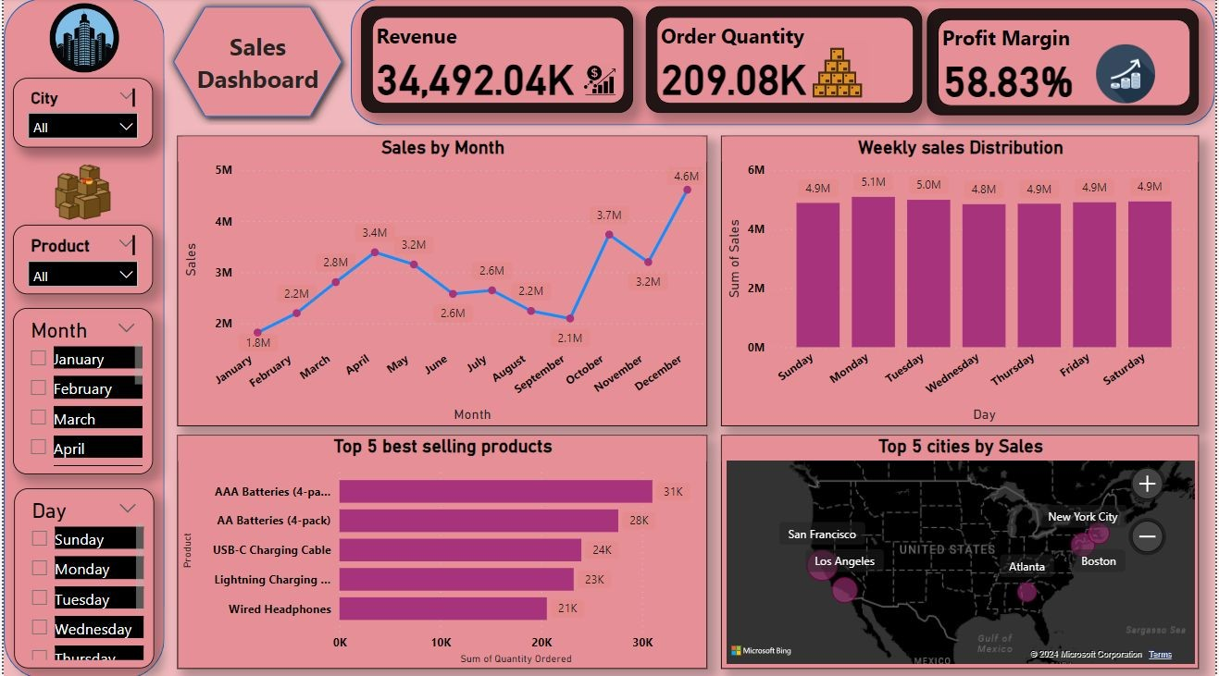
Sales Dashboard
In December, sales reached a peak of 46,13,443.34, surpassing January's lowest total by 153.17%. Notably, December's sales accounted for 13.38% of the annual total. Throughout the year, sales varied widely from a low of 18,22,256.73 to a high of 46,13,443.34 across all 12 months. On Mondays, sales led with a sum of 50,87,956.78, 5.13% higher than the lowest day, Wednesday. Interestingly, AAA Batteries (4-pack) dominated quantity orders with 31,017 units, 50.88% more than Wired Headphones. San Francisco emerged as the top sales performer, with sales totaling 82,62,203.91, a staggering 195.55% higher than Atlanta's lowest sales sum.

Slide 18
05
Recommendations
Actionable Insights

Slide 19




★ Utilize insights from December's peak sales to inform marketing strategies and promotions, aiming to replicate success in other months.
★ Implement targeted initiatives on Mondays to capitalize on the day's higher sales volume, potentially through exclusive promotions or product launches.
★ Focus on promoting AAA Batteries (4-pack) to capitalize on its popularity and capitalize on San Francisco's strong sales performance by allocating additional resources to further penetrate the market.

Slide 20
06
Conclusion and Next steps
Further Analysis

Slide 21





In conclusion, the sales analytics reveal valuable patterns and trends that can guide strategic decision-making and drive business growth.
The next steps involve reﬁning marketing strategies based on monthly sales insights, optimizing promotions for peak days like Mondays, and conducting further market analysis to capitalize on high-performing regions and products.
By leveraging actionable insights and implementing targeted strategies, the organization can enhance sales performance, improve operational efﬁciency, and stay ahead in a competitive market landscape.

Slide 22
Thank You

